Slide 1



Noida Institute of Engineering and Technology, Greater Noida
Context Free Languages
and Grammer
Unit 3
Unit: 3
TAFL
Mr. Rahul Kumar
Assistant Professor
CSE
Course Details (B Tech 4th Sem)

Slide 2

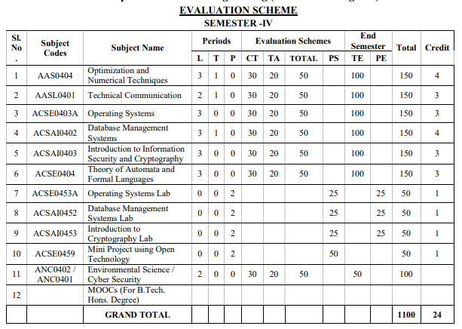
Evaluation Scheme

Slide 3
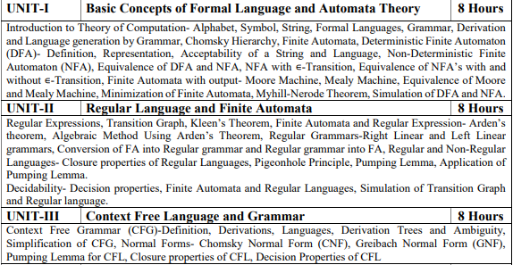
Syllabus

Slide 4
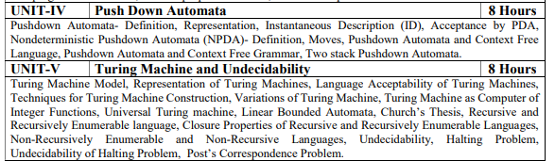
Syllabus

Slide 5
Branch wise Application
The Applications of these Automata are given as follows:
1. Finite Automata (FA) –
For the designing of lexical analysis of a compiler.
For recognizing the pattern using regular expressions.
Used in text editors.
For the implementation of spell checkers.
2. Push Down Automata (PDA) –
For designing the parsing phase of a compiler (Syntax Analysis).
For implementation of stack applications.
For evaluating the arithmetic expressions.
For solving the Tower of Hanoi Problem.
4. Turing Machine (TM) –
For solving any recursively enumerable problem.
For implementation of neural networks.
For implementation of Robotics Applications.
For implementation of artificial intelligence.

Slide 6
Course Objectives
The primary objective of this course is to introduce students to the foundations of computability theory. The other objectives include:
Introduce concepts in automata theory and theory of computation
Identify different formal language classes and their relationships
Design grammars and recognizers for different formal languages
Prove or disprove theorems in automata theory using its properties
Determine the decidability and intractability of computational problems

Slide 7
Content
Context Free Grammar (CFG)-Definition, Derivations, Languages, Derivation Trees and Ambiguity, Simplification of CFG, Normal Forms- Chomsky Normal Form (CNF), Greibach Normal Form (GNF), Pumping Lemma for CFL, Closure properties of CFL, Decision Properties of CFL

Slide 8
Course Outcome
Theory of Automata and Formal Languages (ACSE0404)
Course Outcome (CO) |  | Bloom’s Knowledge Level (KL)
At the end of the course, the student will be able to understand
CO 1 | Design and Simplify automata for formal languages and transform non-deterministic finite automata to deterministic finite automata. |  | K6
CO 2 | Identify the equivalence between the regular expression and finite automata and apply closure properties of formal languages to construct finite automata for complex problems. |  | K3
CO 3 | Define grammar for context free languages and use pumping lemma to disprove a formal language being context- free. |  | K3
CO 4 | Design pushdown automata (PDA) for context free languages and Transform the PDA to context free grammar and vice-versa. |  | K6
CO 5 | Construct Turing Machine for recursive and recursive enumerable languages. Identify the decidable and undecidable problems. |  | K6

Slide 9
CO-PO and PSO Mapping
CO-PO correlation matrix of Theory of Automata and Formal Languages (ACSE0404)
 | PO1 | PO2 | PO3 | PO4 | PO5 | PO6 | PO7 | PO8 | PO9 | PO10 | PO11 | PO12
ACSE0404.1 | 2 | 2 | 3 | 3 | 2 | 2 | - | - | 2 | 1 | - | 3
ACSE0404.2 | 1 | 3 | 2 | 3 | 2 | 2 | - | 1 | 1 | 1 | 2 | 2
ACSE0404.3 | 2 | 2 | 3 | 2 | 2 | 2 | - | 2 | 2 | 1 | 2 | 3
ACSE0404.4 | 2 | 2 | 2 | 3 | 2 | 2 | - | 2 | 2 | 1 | 1 | 3
ACSE0404.5 | 3 | 2 | 2 | 2 | 2 | 2 | - | 2 | 1 | 1 | 1 | 2
Average | 2 | 2.2 | 2.4 | 2.6 | 2 | 2 | - | 1.4 | 1.6 | 1 | 1.2 | 2.6
Mapping of Program Specific Outcomes and Course Outcomes:
Course Outcomes | Program Specific Outcomes
 | PSO1 | PSO2 | PSO3 | PSO4
ACSE0404.1 | 2 | 2 | 2 | 2
ACSE0404.2 | 2 | 2 | 1 | 1
ACSE0404.3 | 2 | 2 | 1 | 1
ACSE0404.4 | 2 | 2 | 1 | 1
ACSE0404.5 | 2 | 2 | 2 | 2
Average | 2 | 2 | 1.4 | 1.4

Slide 10
Program Educational Objectives
PEO1: To have an excellent scientific and engineering breadth so as to comprehend, analyze, design and solve real-life problems using state-of-the-art technologies.
PEO2: To lead a successful career in industries, to pursue higher studies or to support entrepreneurial endeavors so that engineering graduates can face the global challenges.
PEO3:To effectively bridge the gap between industry and academia through effective communication skill, professional attitude, ethical values and a desire to learn.
PEO4: To provide highly competitive environment and solidarity to students for successful professional career as engineer, scientist, entrepreneur and bureaucrats for the betterment of society.

Slide 11
CO-PEO correlation matrix
CO | PEO
 | PEO1 | PEO2 | PEO3 | PEO4
CO1 | 2 | 2 | 1 | 2
CO2 | 2 | 2 | 1 | 1
CO3 | 2 | 2 | 2 | 2
CO4 | 2 | 2 | 1 | 1
CO5 | 2 | 2 | 1 | 2
Average | 2 | 2 | 1.2 | 2

Slide 12
Result Analysis
Subject Result:
Section A: 95.65%
Section B: 97.14%
Section C: 84.51%
Section D: 94.29%

Slide 13

End Semester Question Paper Template
B TECH
(SEM-IV) THEORY EXAMINATION 20__-20__
Theory of Automata and Formal Languages
Time: 3 Hours Total Marks: 100
Note: 1. Attempt all Sections. If require any missing data; then choose suitably.
SECTION A
Attempt all questions in brief. 2 x 10 = 20
Q.No. | Question | Marks | CO
1 |  | 2
2 |  | 2
. |  | .
10 |  | 2

Slide 14
End Semester Question Paper Templates
SECTION B
2. Attempt any three of the following: 3 x 10 = 30
SECTION C
3. Attempt any one part of the following: 1 x 10 = 10
Q.No. | Question | Marks | CO
1 |  | 10
2 |  | 10
. |  | .
5 |  | 10
Q.No. | Question | Marks | CO
1 |  | 10
2 |  | 10

Slide 15
End Semester Question Paper Templates
4. Attempt any one part of the following: 1 x 10 = 10
5. Attempt any one part of the following: 1 x 10 = 10
6. Attempt any one part of the following: 1 x 10 = 10
Q.No. | Question | Marks | CO
1 |  | 10
2 |  | 10
Q.No. | Question | Marks | CO
1 |  | 10
2 |  | 10
Q.No. | Question | Marks | CO
1 |  | 10
2 |  | 10

Slide 16
Unit Objective
To Understand the Regular Grammar.
To understand the context free grammar.
To understand the relationship between FA and Context Free Grammars.
To understand the Normal Forms in Grammar .

Slide 17
Topic Objective
Objective of the Topic
The objective of the topic is to make the student able to:
Understand the CFG.
Realize the expressive power of CFG,CFL.
Understand pumping lemma for CFL.

Slide 18
Prerequisite and Recap
Prerequisite:
Basic concept of rules of grammars of various languages, concept of tree.
Recap:
Regular expressions are the way of representation of the FA.
RE can be converted into FA.
FA can be converted into regular expressions.
Any language can be regular or not which will be proved by Pumping Lemma.

Slide 19
Introduction (CO1, CO2)
Recap: In previous unit we have learned about RE and different Theorems.
Prerequisite: Basic knowledge about Finite Automata and Regular Expressions.
Objective: To understand the basic definition of grammar.

Slide 20
Introduction (CO1, CO2)
Objective: To understand the basic definition of grammar.
A grammar consists of :
A set of variables (non terminals), one of which is represented as start symbol; It is customary to use upper case letters for variables.
A set of terminals ( customary use lower case letters), and
A list of productions (set of rules).

Slide 21
Grammars (CO1, CO2)
A formal definition of a Grammar consists of :
A finite set of rewriting rules in the form of :
α→β,
where α and β are the strings of symbols.
A special “initial” symbol S (S for Sentence);
A finite set of symbols stand for ‘words’ of language called terminal;
[EXAMPLE: a,b,c……+,-…….etc]
Other symbols stand for ‘phrases’ and are known as non terminals.
[EXAMPLE: A,B,C……]

Slide 22
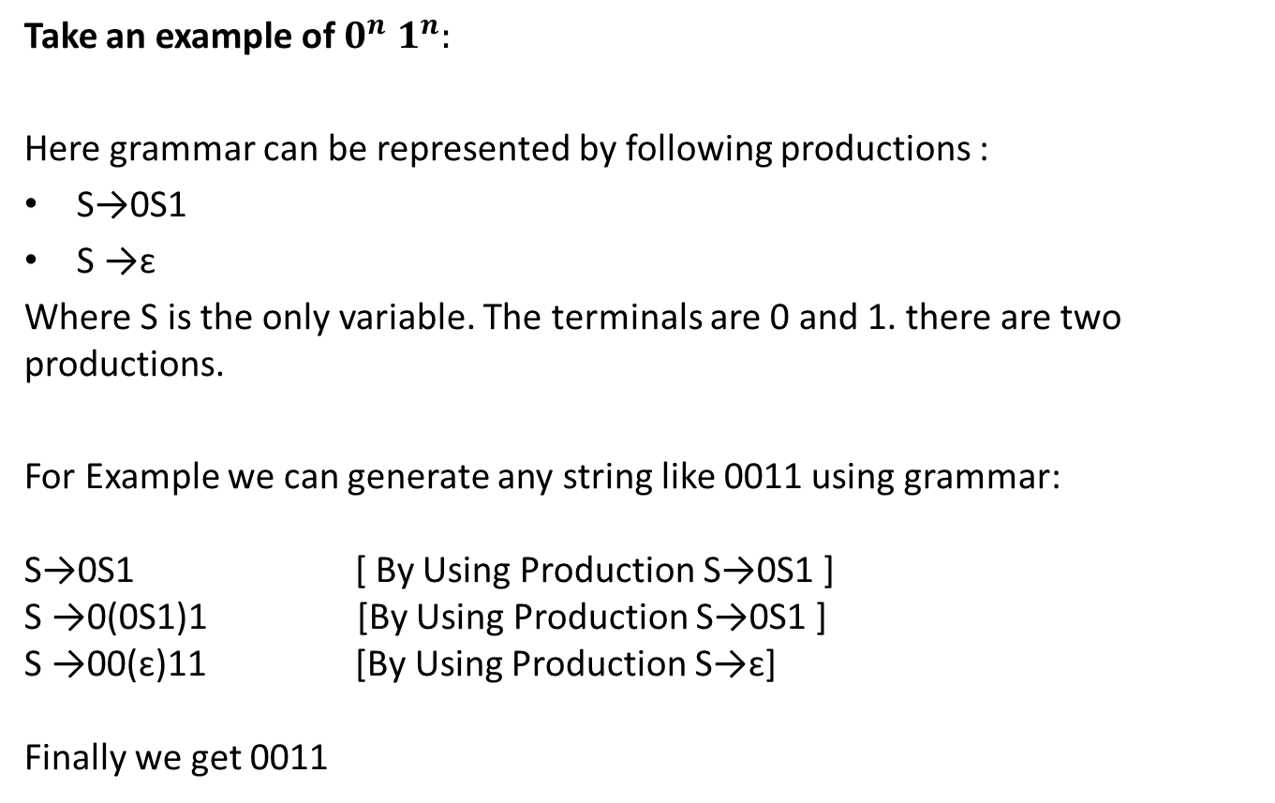
EXAMPLE of GRAMMAR
Take an example of $0^{n}1^{n}:$
Here grammar can be represented by following productions :
S→0S1
S→ɛ
Where S is the only variable. The terminals are 0 and 1. there are two productions.
For Example we can generate any string like 0011 using grammar: S→0S1 [ By Using Production S→0S1 ] S →0(0S1)1 [By Using Production S→0S1 ] S →00(ɛ)11 [By Using Production S→ɛ] Finally we get 0011

Slide 23
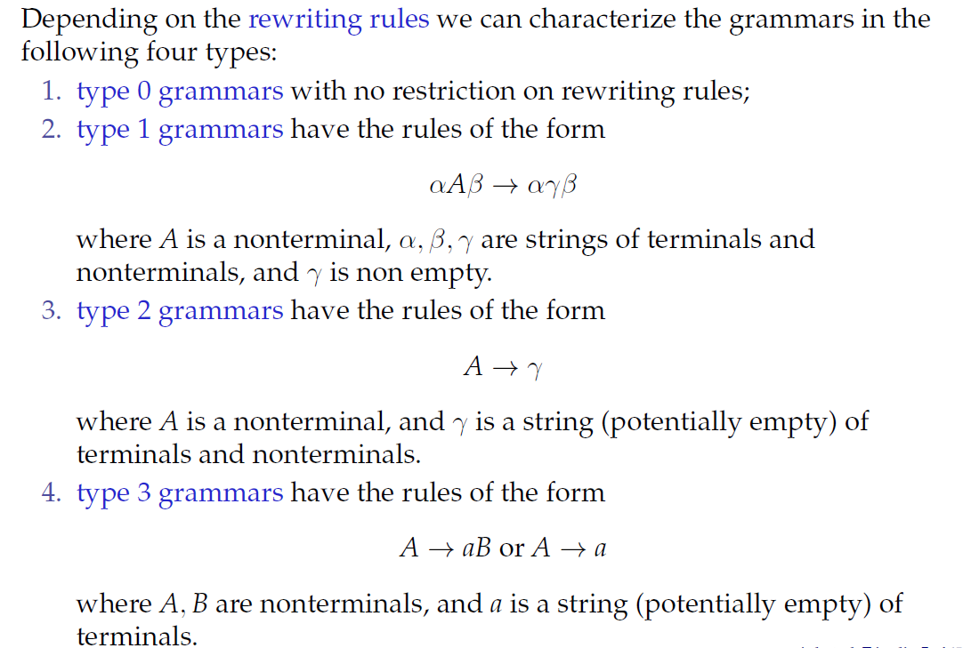
Types of Grammars

Slide 24
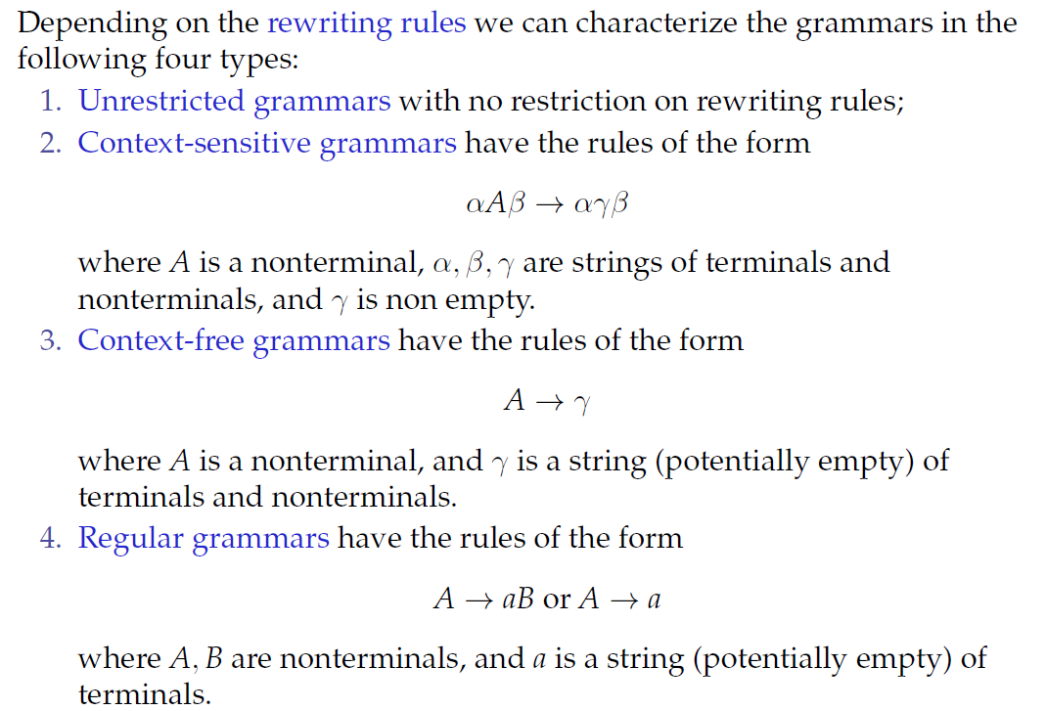
Types of Grammars (Continued)

Slide 25
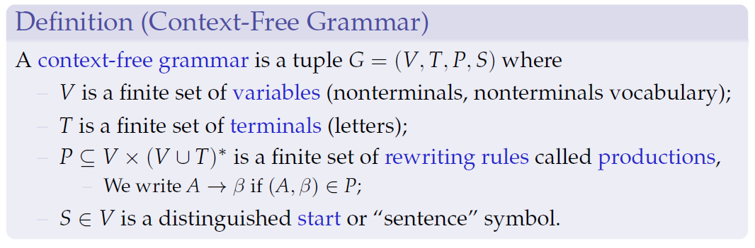
Context-Free Languages: Syntax

Slide 26
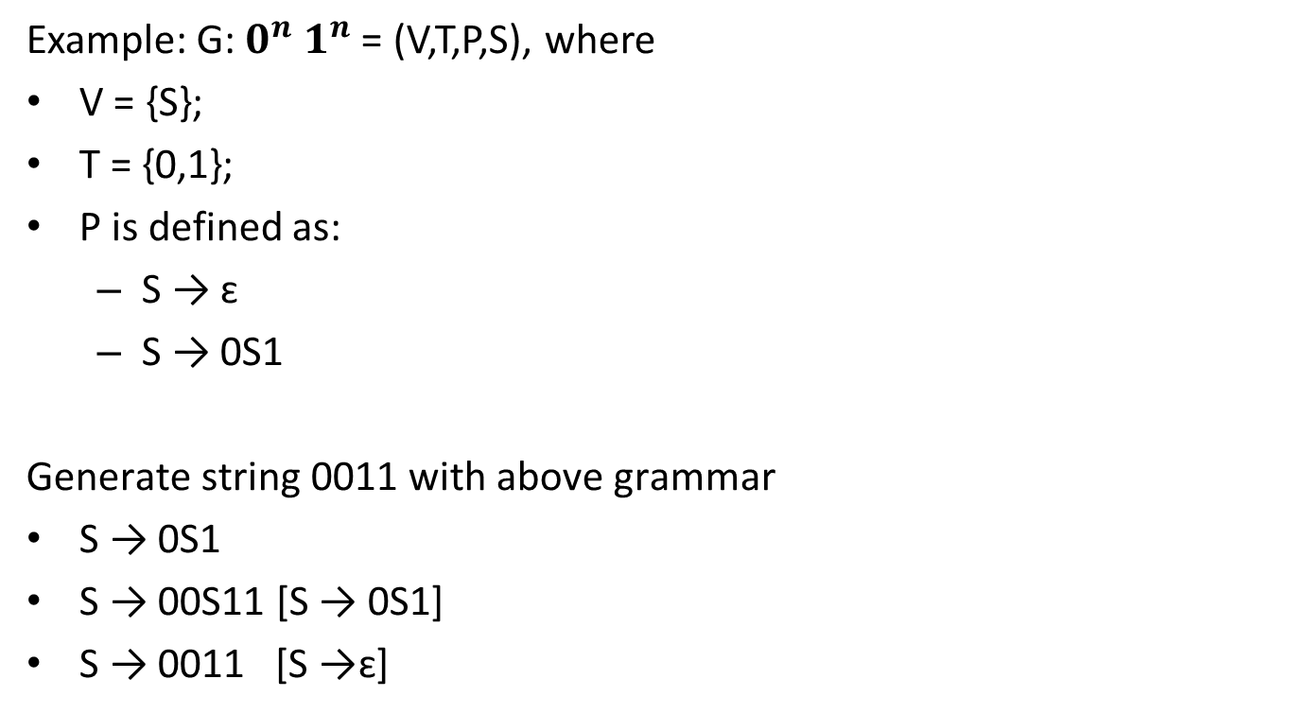
Context-Free Languages: Example
Example: G: $0^{n}1^{n}$ = (V,T,P,S), where
V = {S};
T = {0,1};
P is defined as:
S → ɛ
S → 0S1
Generate string 0011 with above grammar
S → 0S1
S → 00S11 [S → 0S1]
S → 0011 [S →ɛ]

Slide 27
Examples of CFG
Q1: Write CFG which generates palindrome for binary string.
Palindrome is a string which will be same while reading from LHS or RHS example 101, 010…..
S → 0S0/1S1
S → 0/1/ɛ
Generate 0101010
S → 0S0 [S → 0S0 ]
S → 01S10 [S → 1S1 ]
S → 010S010 [S → 0S0 ]
S → 0101010[S → 1]

Slide 28
Examples of CFG
Q2: Write CFG for regular expression r = 0*1(0+1)*
r = 0*1(0+1)*
0* 1 (0+1)*
A B
S →A1B
A →0A/ɛ
B →0B/1B/ɛ

Slide 29
Examples of CFG (CO1, CO2)
Q3: Write CFG for regular expression r = (a+b)*aa(a+b)*
S →AaaA
A →aA/ɛ
A →bA/ɛ
Q4: Set of al strings of length 2
R=(a+b)(a+b)
S →AA
A →a/b

Slide 30
Examples of CFG
Q5: Set of all strings of L=(a+b)*
S →aS/bS/ɛ
Q6: Set of all strings of length at least 2
R= (a+b)(a+b)(a+b)*
S →AAB
A →a/b
B →aB/bB/ɛ
Q7: Set of all strings of length at most 2
R=(a+b+ɛ)(a+b+ɛ)
S →AA
A →a/b/ɛ

Slide 31
Examples of CFG
Q8: For R= a(a+b)*b
S →aAb
A →aA/bA/ɛ

Slide 32
Left Most ad Right Most derivations
A string can be derived in many ways . But we restrict ourselves to :
1. Rightmost Derivations
2. Leftmost Derivations
In leftmost derivations the left most variable of β from (α→β) , is picked for expansion.
In rightmost derivations the right most variable of β from (α→β) , is picked for expansion.

Slide 33
Left Most ad Right Most derivations [Example]
For the grammar given below :
S →A1B
A →0A|ɛ
B →0B|1B|ɛ
Give Leftmost derivation and rightmost derivation of string 1001.
Solution
Leftmost derivation of 1001:
S →A1B
S →1B [A →ɛ]
→10B [B →0B]
→100B [B →0B]
→1001B [B →1B]
→1001 [B →ɛ]

Slide 34
Left Most ad Right Most derivations [Example] (Continued)
Rightmost derivation of 1001:
S →A1B
S →A10B [B →0B]
→A100B [B →0B]
→A1001B [B →1B]
→A1001 [A →ɛ]
→1001 [B →ɛ]

Slide 35
Parse Tree (CO1, CO2)
Recap: Till now we have learned about basic definition of regular grammar and its types.
Prerequisite: Basic knowledge about Finite Automata and Trees.
Objective: To understand the design of parse tree.

Slide 36
Parse Tree (CO1, CO2)
Objective: To understand the design of parse tree
A set of derivations applied to generate a word can be represented using a tree. Such a tree is known as a parse tree. A parse tree representation gives us a better understanding of:
Recursion
Grouping of symbols
A parse tree is constructed with the following conditions:
Root of the tree is represented by start symbol.
Each interior mode is represented by a variable belonging to V.
Each leaf mode is represented by a terminal or ɛ.

Slide 37
Parse Tree [Example]
For a grammar given below S →0S1|01
Give Parse tree derivation of 000111
Derivation using parse tree:
S
S →0S1
0
S
1
S →0S1
0
1
S →01
S
0
1

Slide 38
Ambiguous Grammar (CO1, CO2)
Recap: We have studied about Grammar and its type and Parse Tree.
Prerequisite: Understanding of Grammar.
Objective: To understand the ambiguity of grammar.

Slide 39
Ambiguous Grammar (CO1, CO2)
Objective: To understand the ambiguity of grammar.
Context Free Grammars(CFGs) are classified based on:
Number of Derivation trees
Number of strings
Depending on Number of Derivation trees, CFGs are sub-divided into 2 types:
Ambiguous grammars
Unambiguous grammars

Slide 40
Ambiguous grammar:
A CFG is said to ambiguous if there exists more than one derivation tree for the given input string i.e., more than one Left Most Derivation Tree (LMDT) or Right Most Derivation Tree (RMDT). Definition:
G = (V,T,P,S) is a CFG is said to be ambiguous if and only if there exist a string in T* that has more than on parse tree.
where V is a finite set of variables. T is a finite set of terminals. P is a finite set of productions of the form, A -> α, where A is a variable and α ∈ (V ∪ T)* S is a designated variable called the start symbol.

Slide 41
Ambiguous grammar Example:
S →SS|a|b is ambiguous or not?
Two parse trees can be generated for the string ‘aab’
S
S
S
S
S
S
S
S
b
b
S
S
a
a
a
a

Slide 42
Regular Grammar (CO1, CO2)
Recap: We have studied about Grammar and its type, Parse Tree and Ambiguity of grammar.
Prerequisite: Understanding of Grammar.
Objective: To understand the definition of regular grammar.

Slide 43
Regular Grammar (CO1, CO2)
Objective: To understand the definition of regular grammar.
The language accepted by finite automata can be described using a set of productions known as regular grammar. The productions of a regular grammar are of the following form:
A→a
A →aB
A →Ba
A → ɛ
Where a ϵ T and A,B ϵ V.
A language generated by a regular grammar is known as regular language.

Slide 44
Regular Grammar(Continued)
A regular grammar could be written in two forms
Right Linear Form
Left Linear Form
Right Linear Form:
A right Linear Form has the productions of form:
A →a
A →aB
A →ɛ
Left Linear Form:
A left Linear Form has the productions of the form:
A →a
A →Ba
A →ɛ

Slide 45
DFA to Right Linear Regular Grammar
Given a DFA:
a
_{q0}
_{q1}
a
b
b
b
b
a
_{q2}
_{q3}
a

Slide 46
DFA to Right Linear Regular Grammar (Continued)
Step 1: Rename the states: for q0 which is start state make it as S. rest as a non terminals like A,B,C…
a
_{S}
_{A}
a
b
b
b
b
a
_{B}
_{C}
a

Slide 47
DFA to Right Linear Regular Grammar (Continued)
Step 2: Set of productions are given by:
S → aA|bB
A → aS|bC|b
B → bs|aC|a
C → aB|bA
a
_{S}
_{A}
a
b
b
b
b
a
_{B}
_{C}
a

Slide 48
Right Linear Grammar to DFA
Convert the given Right Linear Grammar to DFA :
S →bB
B →bC|b
B →aB
C →a
STEP 1: Adding transactions corresponding to every production ,we get:
a
_{S}
b
_{B}
b
_{C}
a
_{D}

Slide 49
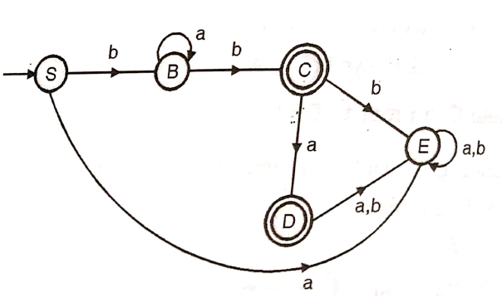
Right Linear Grammar to DFA (Continued)
STEP 2: Adding a state E to handle Φ transitions , final DFA will be:

Slide 50
DFA to Left Linear Grammar
Following steps are required to write a left linear grammar corresponding to a DFA.
Interchange starting state and the final state.
Reverse the direction of all the transactions.
Write the grammar from the transaction graph in left linear form.

Slide 51
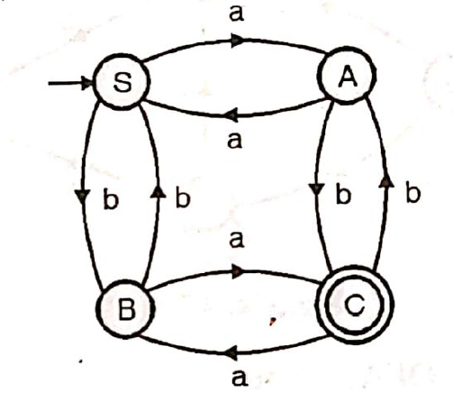
DFA to Left Linear Grammar
Following DFA is Given:

Slide 52
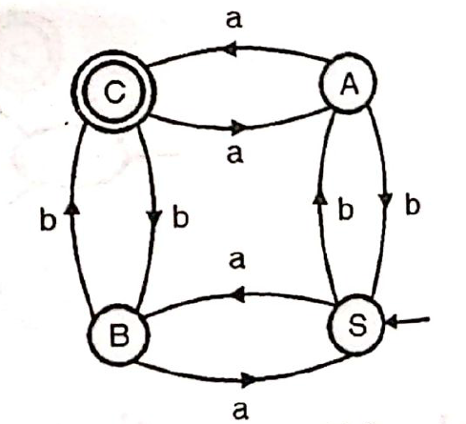
DFA to Left Linear Grammar(Continued)
Interchange the starting state and the final state and reverse the direction of transactions, we get the transaction graph as following:
Writing an equivalent left linear grammar, we get:
S →Ba|Ab, A →Sb|Ca|a
B →Sa|Cb|b, C →Bb|Aa

Slide 53
Left Linear Grammar to DFA
Every left linear grammar can be represented using an equivalent DFA. Following steps are required to draw a DFA for a given left linear grammar.
Draw a transaction graph from the given left linear grammar.
Reverse the direction of all the transactions.
Interchange starting state and the final state.
Carry out conversion from FA to DFA.

Slide 54
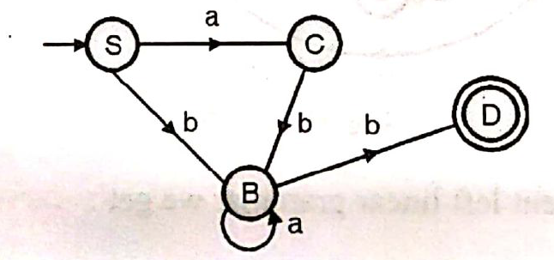
Left Linear Grammar to DFA (Example)
Following Linear grammar is given:
S →Ca|Bb
C →Bb
B →Ba|b
Step 1: Draw a transaction graph from the given left linear grammar:
D is an accepting state. It is added for the production B → b

Slide 55
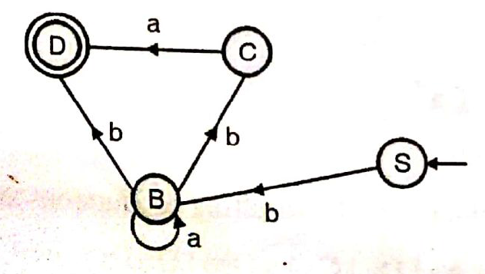
Left Linear Grammar to DFA (Example)
Step 2: Reverse the direction of transaction and interchange starting state and the final state.

Slide 56
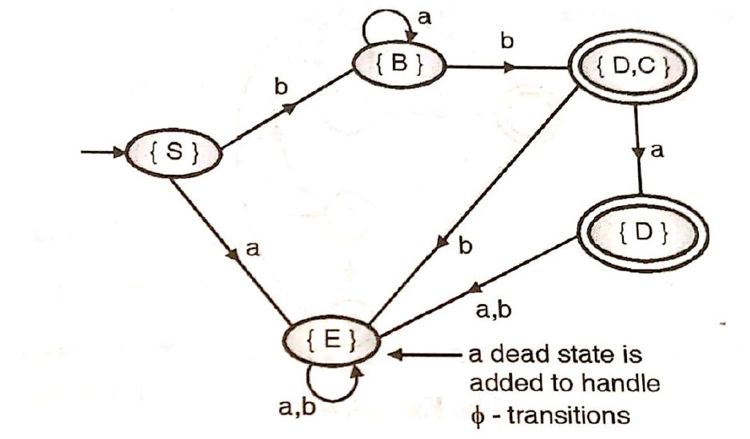
Left Linear Grammar to DFA (Example)
Conversion from FA to DFA:

Slide 57
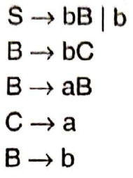
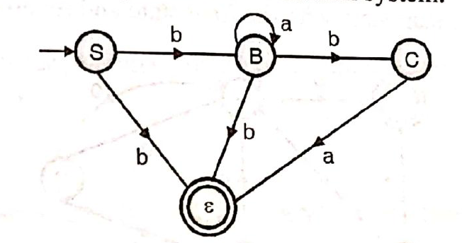
Right Linear Grammar to Left Linear Grammar (CO1, CO2)
Following Right Linear grammar is given:
Step 1: Conversion of Right Linear grammar to transaction system.

Slide 58
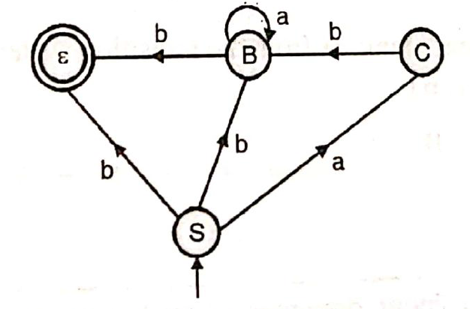
Right Linear Grammar to Left Linear Grammar (Continued)
Step 2: Interchange the start state with the final state and reversing direction of transitions, we get:
Write the left linear grammar from the transaction diagram:
S →b|Bb|Ca
B →Ba|b
C →Bb

Slide 59
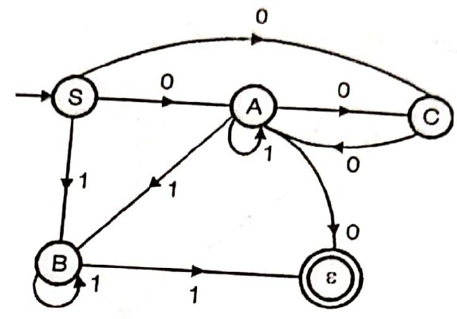
Left Linear Grammar to Right Linear Grammar
A left Linear Grammar is given:
S →C0|A0|B1
A →A1|C0|B1|0
B →B1|1
C →A0
Step 1: Transition system for the left linear grammar if constructed:

Slide 60
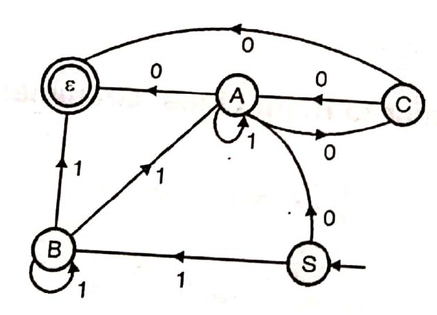
Left Linear Grammar to Right Linear Grammar (Continued)
Step 2: Interchange the start state and the final state and changing direction of all transactions:
Step 3: Following grammar we get:
S →1B|0A
A →0C|1A|0
B →1B|1A|1
C →0C|0

Slide 61
Removal of Unit Productions
Any production rule in the form A → B where A, B ∈ Non-terminal is called unit production.
Removal Procedure −
Step 1 − To remove A → B, add production A → x to the grammar rule whenever B → x occurs in the grammar. [x ∈ Terminal, x can be Null]
Step 2 − Delete A → B from the grammar.
Step 3 − Repeat from step 1 until all unit productions are removed.

Slide 62
Removal of Unit Productions
Problem
Remove unit production from the following −
S → XY,
X → a,
Y → Z | b,
Z → M,
M → N,
N → a
Solution −
There are 3 unit productions in the grammar −
Y → Z, Z → M, and M → N
At first, we will remove M → N.
As N → a, we add M → a, and M → N is removed.
The production set becomes
S → XY, X → a, Y → Z | b, Z → M, M → a, N → a

Slide 63
Removal of Unit Productions (Continued)
Now we will remove Z → M.
As M → a, we add Z→ a, and Z → M is removed.
The production set becomes
S → XY, X → a, Y → Z | b, Z → a, M → a, N → a
Now we will remove Y → Z.
As Z → a, we add Y→ a, and Y → Z is removed.
The production set becomes
S → XY, X → a, Y → a | b, Z → a, M → a, N → a
Now Z, M, and N are unreachable, hence we can remove those.
The final CFG is unit production free −
S → XY, X → a, Y → a | b

Slide 64
Removal of ɛ Productions
Given Grammar:
S→aA
A →b|ɛ
Solution:
Substitute ɛ on production S→aA
S→a[ɛ]
S→a
Then add this production into main one:
S→aA|a
A →b

Slide 65
Chomsky Normal Form (CO1, CO2)
Recap: Till now we have studied about grammar, Context Free Grammar and Regular Grammar.
Prerequisite: Basic knowledge of CFG and Regular Grammar.
Objective: To understand the definition on Chomsky Normal Form.

Slide 66
Chomsky Normal Form (CO1, CO2)
Objective: To understand the definition on Chomsky Normal Form.
A CFG is in Chomsky Normal Form if the Productions are in the following forms −
A → a
A → BC
S → ε
where A, B, and C are non-terminals and a is terminal.

Slide 67
Algorithm to Convert into Chomsky Normal Form
Step 1 − If the start symbol S occurs on some right side, create a new start symbol S’ and a new production S’→ S.
Step 2 − Remove Null productions. (Using the Null production removal algorithm discussed earlier)
Step 3 − Remove unit productions. (Using the Unit production removal algorithm discussed earlier)
Step 4 − Replace each production A → B₁…B_{n} where n > 2 with A → B₁C where C → B₂ …B_{n}. Repeat this step for all productions having two or more symbols in the right side.
Step 5 − If the right side of any production is in the form A → aB where a is a terminal and A, B are non-terminal, then the production is replaced by A → XB and X → a. Repeat this step for every production which is in the form A → aB.

Slide 68
Chomsky Normal Form(Continued)
Problem
Convert the following CFG into CNF
S → ASA | aB, A → B | S, B → b | ε
Solution
(1) Since S appears in R.H.S, we add a new state S₀ and S₀→S is added to the production set and it becomes −
S₀→S, S→ ASA | aB, A → B | S, B → b | ∈

Slide 69
Chomsky Normal Form(Continued)
(2) Now we will remove the null productions −
B → ∈ and A → ∈
After removing B → ε, the production set becomes −
S₀→S, S→ ASA | aB | a, A → B | S | ∈, B → b
After removing A → ∈, the production set becomes −
S₀→S, S→ ASA | aB | a | AS | SA | S, A → B | S, B → b

Slide 70
Chomsky Normal Form(Continued)
(3) Now we will remove the unit productions.
After removing S → S, the production set becomes −
S₀→S, S→ ASA | aB | a | AS | SA, A → B | S, B → b
After removing S₀→ S, the production set becomes −
S₀→ ASA | aB | a | AS | SA, S→ ASA | aB | a | AS | SA
A → B | S, B → b
After removing A→ B, the production set becomes −
S₀ → ASA | aB | a | AS | SA, S→ ASA | aB | a | AS | SA
A → S | b
B → b
After removing A→ S, the production set becomes −
S₀ → ASA | aB | a | AS | SA, S→ ASA | aB | a | AS | SA
A → b |ASA | aB | a | AS | SA, B → b

Slide 71
Chomsky Normal Form(Continued)
(4) Now we will find out more than two variables in the R.H.S
Here, S₀→ ASA, S → ASA, A→ ASA violates two Non-terminals in R.H.S.
Hence we will apply step 4 and step 5 to get the following final production set which is in CNF −
S₀→ AX | aB | a | AS | SA
S→ AX | aB | a | AS | SA
A → b |AX | aB | a | AS | SA
B → b
X → SA

Slide 72
Chomsky Normal Form(Continued)
(5) We have to change the productions S₀→ aB, S→ aB, A→ aB
And the final production set becomes −
S₀→ AX | YB | a | AS | SA
S→ AX | YB | a | AS | SA
A → b A → b |AX | YB | a | AS | SA
B → b
X → SA
Y → a

Slide 73
Greibach Normal Form (CO1, CO2)
Recap: Till now we have studied about grammar, Context Free Grammar and Regular Grammar.
Prerequisite: Basic knowledge of CFG and Regular Grammar.
Objective: To understand the definition on Greibach Normal Form.

Slide 74
Greibach Normal Form (CO1, CO2)
Objective: To understand the definition on Greibach Normal Form.
A CFG is in Greibach Normal Form if the Productions are in the following forms −
A → b
A → bD₁…D_{n}
S → ε
where A, D₁,....,D_{n} are non-terminals and b is a terminal.

Slide 75
Algorithm to Convert a CFG into Greibach Normal Form
Step 1 − If the start symbol S occurs on some right side, create a new start symbol S’ and a new production S’ → S.
Step 2 − Remove Null productions. (Using the Null production removal algorithm discussed earlier)
Step 3 − Remove unit productions. (Using the Unit production removal algorithm discussed earlier)
Step 4 − Remove all direct and indirect left-recursion.
Step 5 − Do proper substitutions of productions to convert it into the proper form of GNF.

Slide 76
Greibach Normal Form(Continued)
Question:
Convert the following CFG into CNF
S → XY | Xn | p
X → mX | m
Y → Xn | o

Slide 77
Greibach Normal Form(Continued)
Solution
Here, S does not appear on the right side of any production and there are no unit or null productions in the production rule set. So, we can skip Step 1 to Step 3.
Now after replacing
X in S → XY | Xo | p
with
mX | m
we obtain
S → mXY | mY | mXo | mo | p.
And after replacing
X in Y → X_{n} | o
with the right side of
X → mX | m
we obtain
Y → mXn | mn | o.

Slide 78
Greibach Normal Form(Continued)
Two new productions O → o and P → p are added to the production set and then we came to the final GNF as the following −
S → mXY | mY | mXC | mC | p
X → mX | m
Y → mXD | mD | o
O → o
P → p

Slide 79
Pumping Lemma for CFL
Pumping Lemma for Context-free Languages (CFL) Pumping Lemma for CFL states that for any Context Free Language L, it is possible to find two substrings that can be ‘pumped’ any number of times and still be in the same language.
For any language L, we break its strings into five parts and pump second and fourth substring. Pumping Lemma, here also, is used as a tool to prove that a language is not CFL. Because, if any one string does not satisfy its conditions, then the language is not CFL. Thus, if L is a CFL, there exists an integer n, such that for all x ∈ L with |x| ≥ n, there exists u, v, w, x, y ∈ Σ*, such that x = uvwxy, and (1) |vwx| ≤ n (2) |vx| ≥ 1 (3) for all i ≥ 0: uviwxiy ∈ L

Slide 80
Pumping Lemma for CFL
(Continued)
For above example, 0n1n is CFL, as any string can be the result of pumping at two places, one for 0 and other for 1.
Let us prove, L012 = {0n1n2n | n ≥ 0} is not Context-free.
Let us assume that L is Context-free, then by Pumping Lemma, the above given rules follow. Now, let x ∈ L and |x| ≥ n.
So, by Pumping Lemma, there exists u, v, w, x, y such that (1) – (3) hold. We show that for all u, v, w, x, y (1) – (3) do not hold. If (1) and (2) hold then x = 0n1n2n = uvwxy with |vwx| ≤ n and |vx| ≥ 1. (1) tells us that vwx does not contain both 0 and 2. Thus, either vwx has no 0’s, or vwx has no 2’s. Thus, we have two cases to consider. Suppose vwx has no 0’s. By (2), vx contains a 1 or a 2. Thus uwy has ‘n’ 0’s and uwy either has less than ‘n’ 1’s or has less than ‘n’ 2’s. But (3) tells us that uwy = uv0wx0y ∈ L. So, uwy has an equal number of 0’s, 1’s and 2’s gives us a contradiction. The case where vwx has no 2’s is similar and also gives us a contradiction. Thus L is not context-free.

Slide 81
Properties of Context-Free Languages
Properties of Context-Free Languages
Decision Properties
Closure Properties

Slide 82
Properties of Context-Free Languages (Continued)
As usual, when we talk about “a CFL” we really mean “a representation for the CFL, e.g., a CFG or a PDA accepting by final state or empty stack.
There are algorithms to decide if:
String w is in CFL L.
CFL L is empty.
CFL L is infinite.

Slide 83
Properties of Context-Free Languages (Continued)
We already did this.
We learned to eliminate variables that generate no terminal string.
If the start symbol is one of these, then the CFL is empty; otherwise not.

Slide 84
Properties of Context-Free Languages (Continued)
Want to know if string w is in L(G).
Assume G is in CNF.
Or convert the given grammar to CNF.
w = ε is a special case, solved by testing if the start symbol is nullable.
Algorithm (CYK ) is a good example of dynamic programming and runs in time O(n³), where n = |w|.

Slide 85
Properties of Context-Free Languages (Continued)
Let w = a₁…a_{n}.
We construct an n-by-n triangular array of sets of variables.
X_{ij} = {variables A | A =>* a_{i}…a_{j}}.
Induction on j–i+1.
The length of the derived string.
Finally, ask if S is in X_{1n}.

Slide 86
Properties of Context-Free Languages (Continued)
Basis: X_{ii} = {A | A -> a_{i} is a production}.
Induction: X_{ij} = {A | there is a production A -> BC and an integer k, with i < k < j, such that B is in X_{ik} and C is in X_{k+1,j}.

Slide 87
Properties of Context-Free Languages (Continued)
Grammar: S -> AB, A -> BC | a, B -> AC | b, C -> a | b
String w = ababa
X₁₂={B,S}
X₂₃={A} X₃₄={B,S} X₄₅={A}
X₁₁={A,C} X₂₂={B,C} X₃₃={A,C} X₄₄={B,C} X₅₅={A,C}

Slide 88
Properties of Context-Free Languages (Continued)
Grammar: S -> AB, A -> BC | a, B -> AC | b, C -> a | b
String w = ababa
X₁₃={}
Yields nothing
X₁₂={B,S}
X₂₃={A} X₃₄={B,S} X₄₅={A}
X₁₁={A,C} X₂₂={B,C} X₃₃={A,C} X₄₄={B,C} X₅₅={A,C}

Slide 89
Properties of Context-Free Languages (Continued)
Grammar: S -> AB, A -> BC | a, B -> AC | b, C -> a | b
String w = ababa
X₁₃={A}
X₂₄={B,S} X₃₅={A}
X₁₂={B,S}
X₂₃={A} X₃₄={B,S} X₄₅={A}
X₁₁={A,C} X₂₂={B,C} X₃₃={A,C} X₄₄={B,C} X₅₅={A,C}

Slide 90
Properties of Context-Free Languages (Continued)
Grammar: S -> AB, A -> BC | a, B -> AC | b, C -> a | b
String w = ababa
X₁₄={B,S}
X₁₃={A}
X₂₄={B,S} X₃₅={A}
X₁₂={B,S}
X₂₃={A} X₃₄={B,S} X₄₅={A}
X₁₁={A,C} X₂₂={B,C} X₃₃={A,C} X₄₄={B,C} X₅₅={A,C}

Slide 91
Properties of Context-Free Languages (Continued)
The idea is essentially the same as for regular languages.
Use the pumping lemma constant n.
If there is a string in the language of length between n and 2n-1, then the language is infinite; otherwise not.
Let’s work this out in class.

Slide 92
Properties of Context-Free Languages (Continued)
CFL’s are closed under union, concatenation, and Kleene closure.
Also, under reversal, homomorphisms and inverse homomorphisms.
But not under intersection or difference.

Slide 93
Properties of Context-Free Languages (Continued)
Form a new grammar for L ∪ M by combining all the symbols and productions of G and H.
Then, add a new start symbol S.
Add productions S -> S₁ | S₂.

Slide 94
Properties of Context-Free Languages (Continued)
In the new grammar, all derivations start with S.
The first step replaces S by either S₁ or S₂.
In the first case, the result must be a string in L(G) = L, and in the second case a string in L(H) = M.

Slide 95
Properties of Context-Free Languages (Continued)
Let L and M be CFL’s with grammars G and H, respectively.
Assume G and H have no variables in common.
Let S₁ and S₂ be the start symbols of G and H.

Slide 96
Closure Under Concatenation – (2)
Properties of Context-Free Languages (Continued)
Form a new grammar for LM by starting with all symbols and productions of G and H.
Add a new start symbol S.
Add production S -> S₁S₂.
Every derivation from S results in a string in L followed by one in M.

Slide 97
Faculty Video Links, Youtube & NPTEL Video Links and Online Courses Details
My Video :
https://www.youtube.com/feed/my_videos
Youtube/other Video Links
https://www.youtube.com/watch?v=6b40kKe2SFg
https://www.youtube.com/watch?v=-aIRqNnUvEg&list=PL85CF9F4A047C7BF7
https://www.youtube.com/watch?v=Xk-MTgB68rQ

Slide 98
Daily Quiz
Let G be the grammar S → aB | bA, A →a | aS | bAA, B → b | bS | aBB. For the string aaabbabbba find
Parse tree
Leftmost derivation
Rightmost derivation
Is the grammar unambiguous?
Write the grammar generating the language L = {a^{n}b^{m} | where n≠m}
Define the Chomsky Normal Form (CNF). Convert the grammar given
below to its equivalent CNF:
S → ABA
A → 0A | є
B → 1B | є
4. Using pumping lemma for CFLs prove that language is not Context Free.

Slide 99
Daily Quiz (Continued)
5. The following grammar generates the regular expression 0*1(0+1)*
S→A1B
A→0A| ɛ
B→0B|1B|ɛ
Give leftmost and rightmost derivation of the string 00101
6. Give the CFG of the following language:
0(0+1)*01(0+1)*1
7. Find the CFG of following language
L={a^{i}b^{j}c^{k}|i=j+k}
8. Give CFG for matching parenthesis.
9. Give CFG for all strings with at least two 0s, over an alphabet {0,1}.
10. Write an equivalent right recursive grammar for the given left recursive grammar: S→S10|0

Slide 100
Weekly Assignment
Write Context Free Grammars for Following: [C03]
L= {0^{n}1^{n+m}2^{m+p}3^{p} where n, m, p>=1}
L= {w: w consists of all strings containing a and b which are palindromes}
L= {w: w consists of all strings containing a & b which are even length palindromes}
L= { a^{n}b^{m}: n≠ m}
L= {a^{n}a^{m}b^{k} :n=m or m<=k }
L= {a^{n}b^{m}c^{k} :n=m or m≠k }
L= {a^{n}b^{m}c^{k} :k = n + 2m } where n, m>0
L= {a^{n}b^{m}c^{k} : k = |n – m | } where n, m, k>0
L= {a^{n}ww^{R}b^{n} : wЄ (a/b)* , n>=1}
L= { w: w Є (a/b)*, which generates string of balanced parenthesis

Slide 101
Weekly Assignment
Write a CFG for language L(G) containing strings with at least one a. [C03]
Write a CFG for language L(G) containing strings with at least 3 a. [C03]
Consider G = ({A, B}, {a, b, c}, A, P) with productions [C03]
A→a|aaA|abBc B→abbA|b
Convert the grammar into CNF.
Show that two grammars [C03]
S→abAB|ba, A→aaa, B→aA|bb and
S→abAaA|abAbb|ba, A→aaa are equivalent.

Slide 102
Weekly Assignment
Eliminate the useless productions from the grammar [C03]
S→aS|AB, A→bA, B→AA
What language this grammar generates.
Find a Context Free Grammar without λ Productions equivalent to the grammar defined by:
S→AaB|aaB, A→ λ, B→bbA| λ [C03]
Convert the following grammar into CNF [C03]
S→AACD, A→aAb| λ, C→aC| λ, D→aDa|bDb| λ
Remove all Unit productions, all useless productions, and all λ productions from the grammar
S→aA|aBB, A→aaA| λ, B→bB|bbC, C→B [C03]
Find a Context Free Grammar without λ Productions equivalent to the grammar defined by:
S→AaB|aaB, A→ λ, B→bbA| λ [C03]
Use pumping lemma to prove language L = a^{n}b^{n}c^{n} is not context free. [C03]

Slide 103
MCQ s
The alphabet over which the language is defined is represented in CFG as:
non-terminals
terminals
star symbols
Productions
2. In a CFG left hand side production is
a single non terminal
a single terminal
two non-terminals
combination of terminals and non-terminals

Slide 104
MCQ s( Continued)
3. Which one is not a CFG?
S→a
aA→b
S→aA
S→Sb
4. Following productions represent which language: A→a, A→b
{ab}
{ba}
{a,b}
{a}

Slide 105
MCQ s( Continued)
5. Which one is a unit production?
A→B
A→aB
A→Bb
A→a
6. the production S→ABC can be converted to S→AX by adding
S→AB
X→BC
X→AB
X→ABC
7. In parse tree the interior nodes are:
starting symbol
terminal
non terminal except start symbol
null symbol

Slide 106
MCQ s( Continued)
8. Terminals can be only in ………. in case of parse tree:
root
leaves
nodes
none of these
9. In case of productions A→aB, A→a the state B is in :
initial
final
intermediate
Dead
10. in case of a CFG in regular form the productions should be in which form:
A→aB|a
A→Ba
A→a
A→CV

Slide 107
Expected Questions for University Exam
Let G = ({ S,C},{a,b},P,S) where P consistes of S→aCa, C→aCa|b. Find L(G).
Find L(G), where G = ({ S},{0,1},{S→0S1, S→ɛ},S)
Find out the context free language
S→aSb|aAb
A→bAa
A→ba
4. Give the CFG of the following language:
0(0+1)*01(0+1)*1
5. Give CFG for matching parenthesis.

Slide 108
Old Question Papers
https://drive.google.com/drive/folders/19Eia3VHCl3627foiH6V_j-p4X9ZkyyC7?usp=sharing

Slide 109
Summary
There are basically two types of derivations of strings from the grammar, namely, top down derivations and bottom up derivations.
Parse tree can be constructed for each derivations.
Ambiguous grammars and normal forms for the grammars were also discussed in this unit.

Slide 110
References
Aho, Hopcroft and Ullman, The Design and Analysis of Computer Algorithms, Addison Wesley.
Aho, Sethi, Ullman, Compilers Principles, Techniques and Tools, Pearson Education, 2003.
Hopcroft and Ullman, Introduction to Automata Theory, Languages and Computation, Addison Wesley.
Kohavi, ZVI, Switching And Finite Automata Theory, Tata McGraw-Hill, 2006.
Lewis and Papadimitriou, Elements of the Theory of Computation, Prentice-Hall.
Martin, Introduction to Languages and the Theory of Computation, McGraw-Hill, 2nd edition,1996.
Mishra, KLP, Chandrasekaran, N. Theory of Computer Science, (Automata, Languages and Computation) PHI, 2002.

Slide 111
Noida Institute of Engineering and Technology, Greater Noida
Thank You

